Slide 1


IMPROVING WAREHOUSE OPERATIONS OF NAMET THROUGH LAYOUT REDESIGN- A KAIZEN IMPLEMENTATION

Slide 2
Members of Project
Ege Dağcı
Rebecca Sadeghi
Yeliz Altan
Mert Saylam
Nükhet Karagöz
Academic Advisor
Aysu Göçer
Industrial Advisor
Feyza Türk

Slide 3
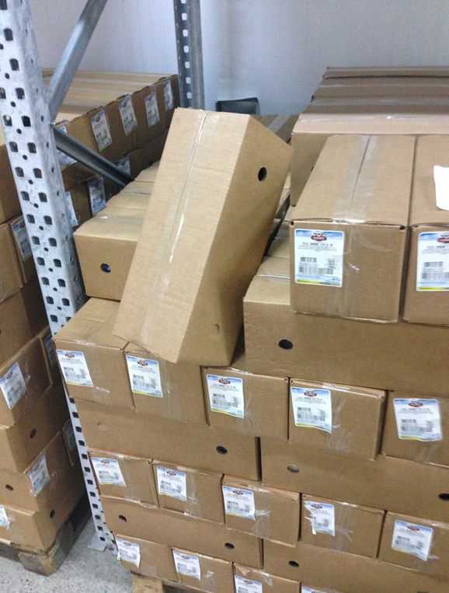
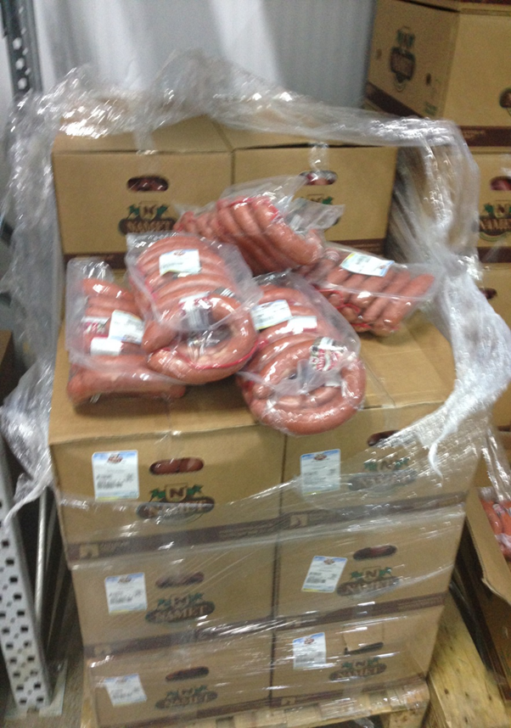
Namet was facing problems in...
Efficient use of space
Product Addressing
FIFO Strategy
Disordered products/vehicles/equipments
Order Picking

Slide 4
WHAT WE AIMED?
THE OBJECTIVE WAS TO
Improve the Warehouse Operations of Namet through Warehouse Layout Redesign
Warehouse Layout
Data Collection and Analysis
Netsis
Kaizen
Warehouse Operations Mapping
5S

Slide 5
METHODOLOGY
FIELD NOTES
INTERVIEWS
With employees
Weekly visits to Namet warehouse
OBSERVATION
Spent 10 hours per week for observing the daily operations in the warehouse for 10 weeks of period
Company managers
Other executives (e.g. experts on Kaizen implementations)
Warehouse processes and observations were recorded.

Slide 6
WHAT WE HAVE COMPLETED?
Problem Definition
Literature Review
Observations in the Warehouse: 14 field visits (700 hours) to Namet warehouse
Interviews with Namet managers / workers
Warehouse Operations Process Mapping
5S Templates
5S Layout Template
5S Audit Template
Data Collection and Analysis (initial version)

Slide 7
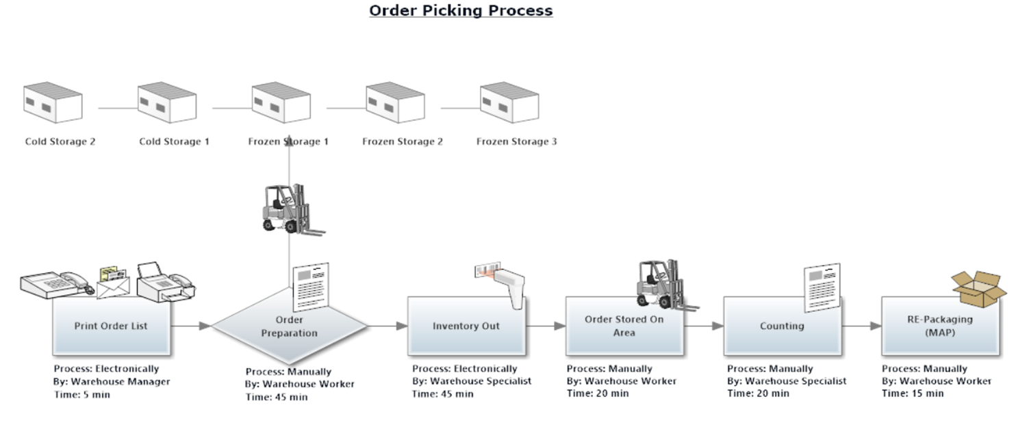
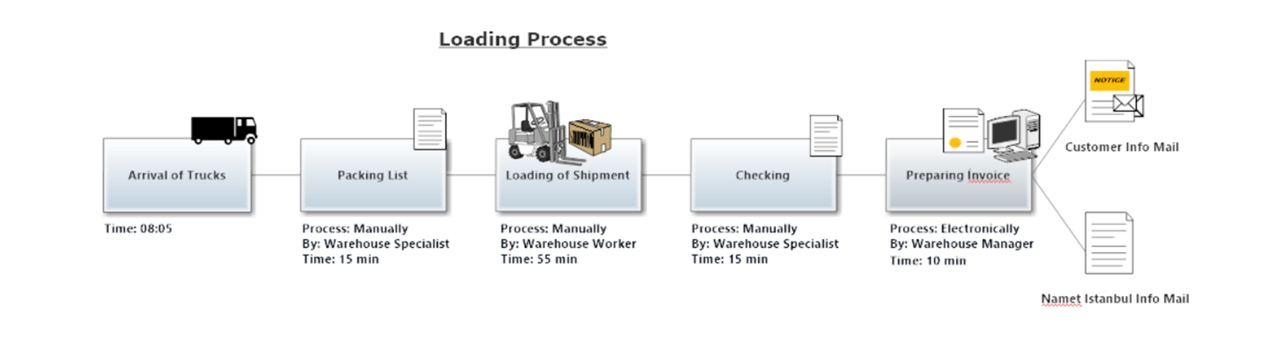
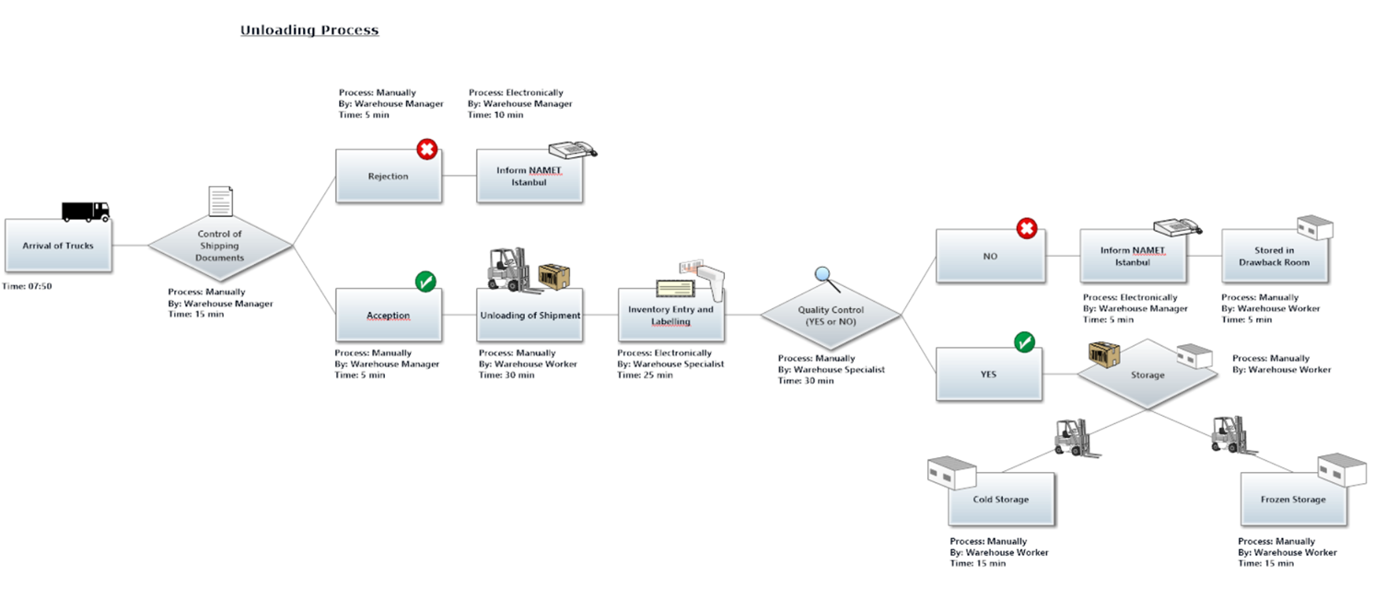
WAREHOUSE OPERATIONS PROCESS MAPPING
Order Picking
Loading
Unloading

Slide 8
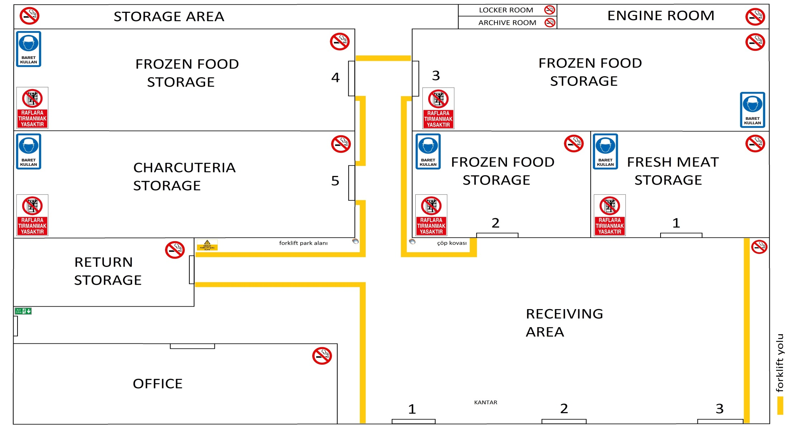
5S TEMPLATE LAYOUT

Slide 9
5S AUDIT TEMPLATE
5S Denetim Şablonu 2013.xlsx

Slide 10
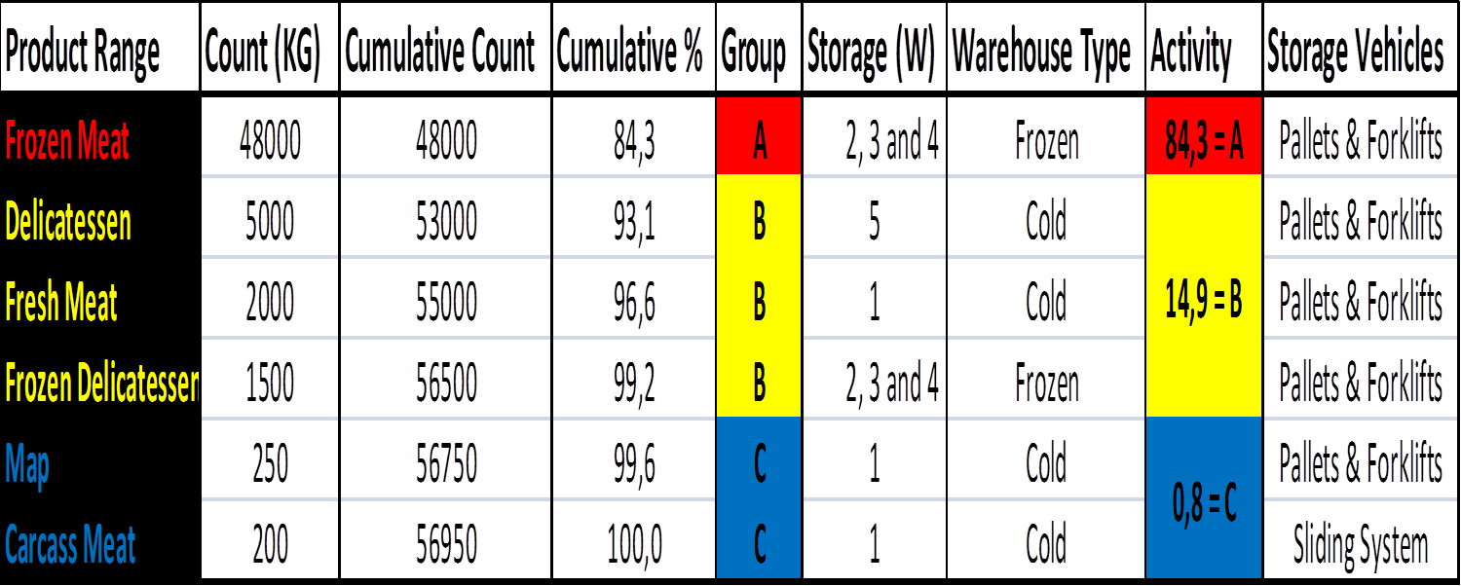
DATA COLLECTION and ANALYSIS (INITIAL VERSION)

Slide 11
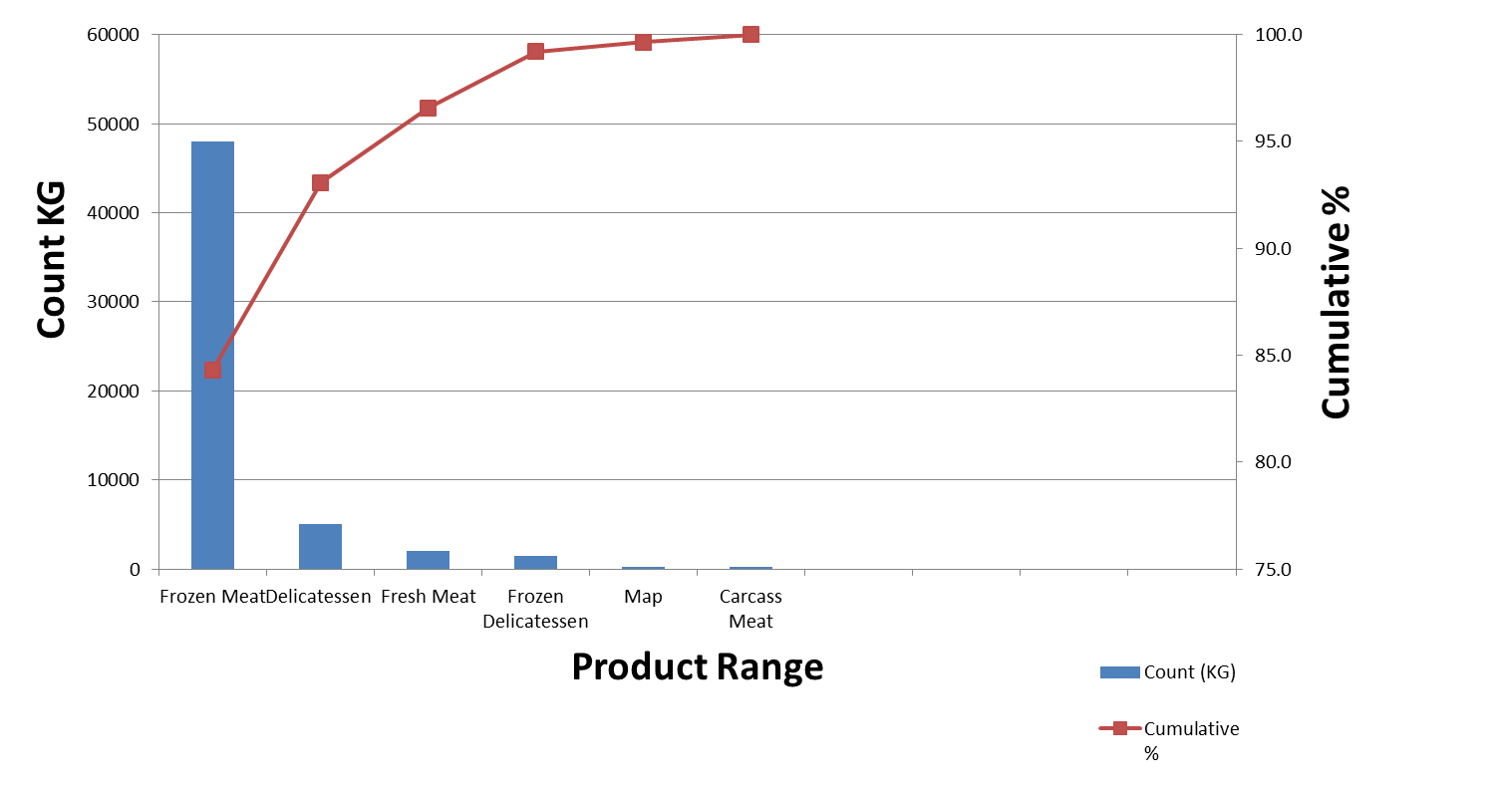
GRAPH of PRODUCT INTENSITY

Slide 12
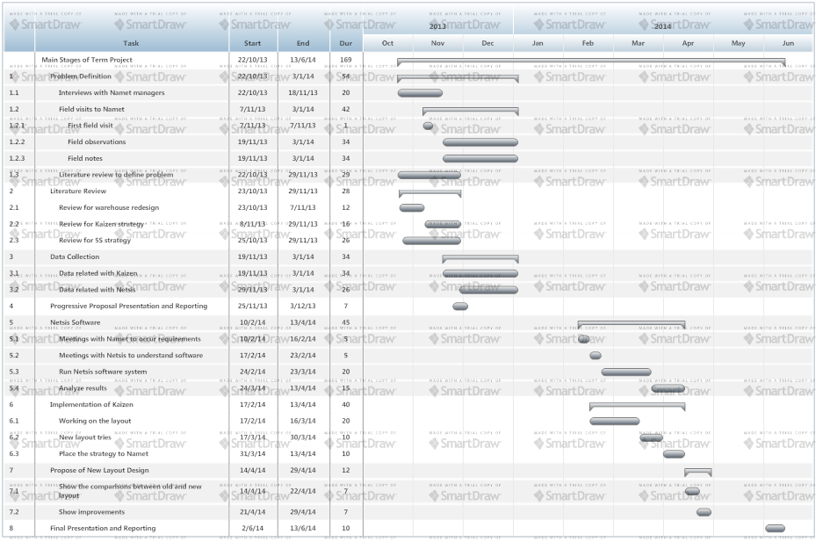
GANTT CHART

Slide 13
WHAT WILL WE DO?
1) DATA COLLECTION and ANALYSIS
data collection from Namet
analysis of the data
reorganizing the data to a more meaningfull form to be used in warehouse layout redesign decisions
outline storage conditions and limitations for each product item
identify the potential storage layout

Slide 14
WHAT WILL WE DO?
2) NETSIS SIDE
meet with Netsis consultants to learn how to use the module and upload the data into the system
work to design the Netsis Warehouse Design module available for the analysis
run Netsis Warehouse Design Module and outline the proposed layout by the system

Slide 15
WHAT WILL WE DO?
3) WAREHOUSE REDESIGN PROPOSAL
compare, analyze and consider the alternative layouts outlined
decide on the most proper warehouse layout design for Namet
present warehouse redesign proposal to the Namet managers and make necessary adjustments
present the complete project to the lecturers and others

Slide 16


